Slide 1
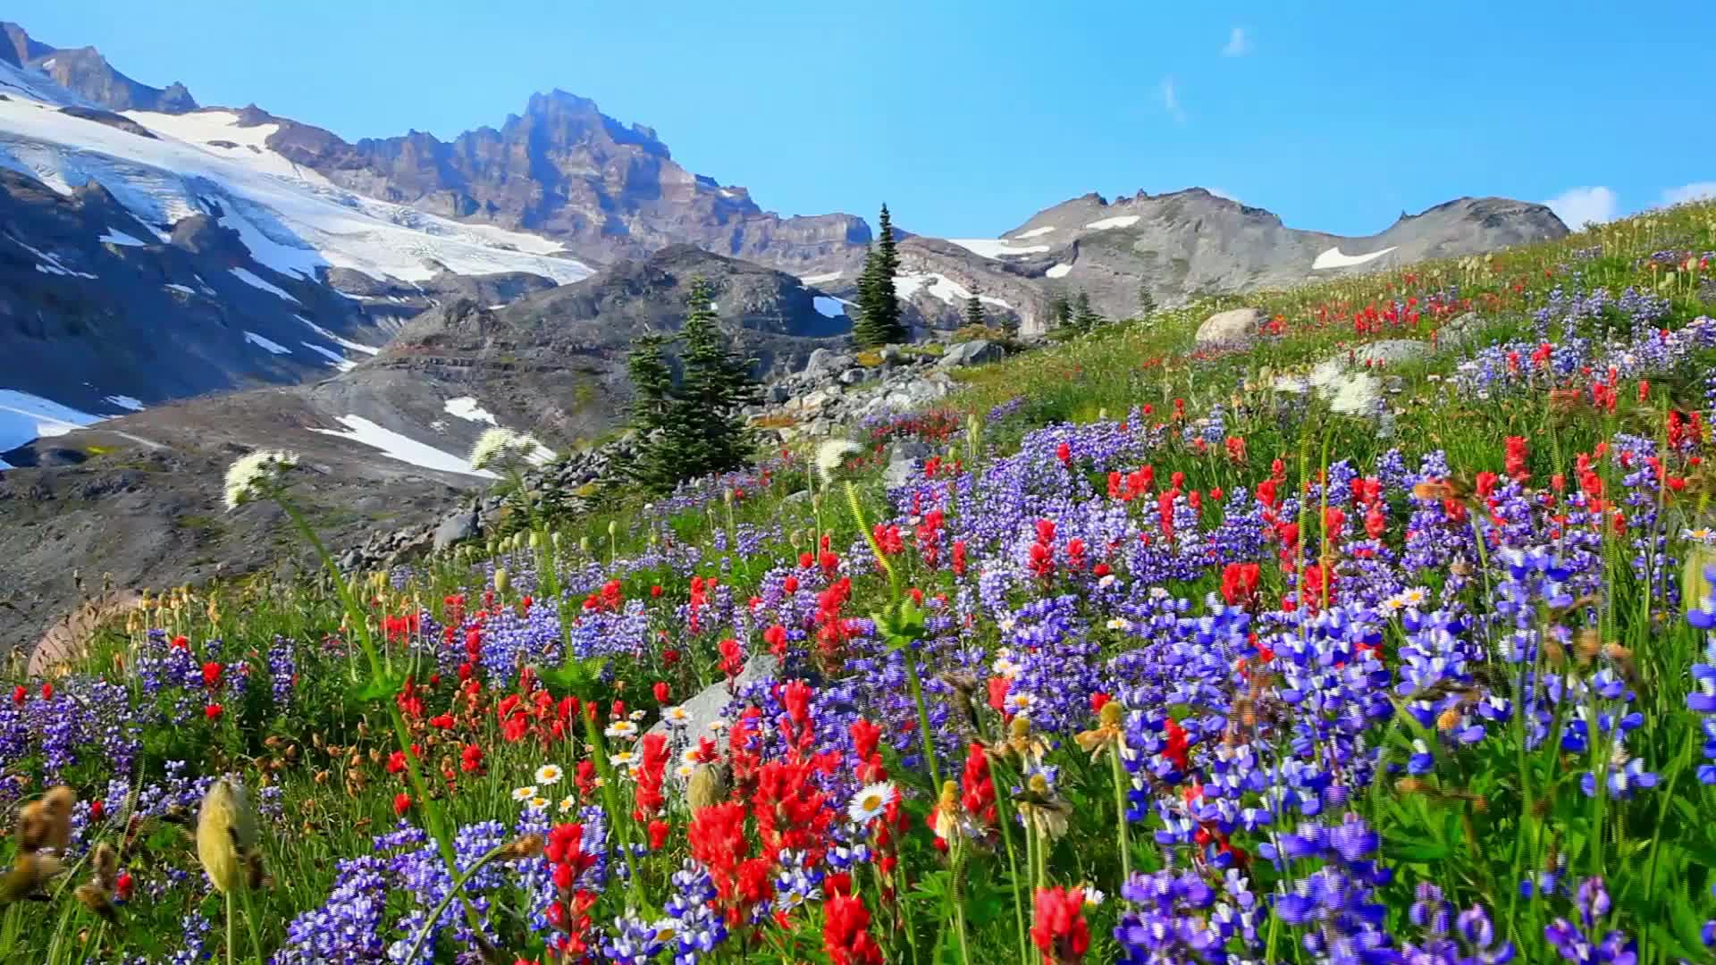
Cascade Meadows

Slide 2

Management Report
2025 ANNUAL MEMBERS MEETING
What’s happened since we last met:
HOA Dues raised to $178 starting January 1, 2025. This comes from the community vote and approval to raise dues with an 8% increase through 2031, the stabilize at $260 per month.
Peirce Enterprise was utilized for snow removal at the community during winter 2024-2025
The board motioned to put several contracts in place for 2025. Curtis Lawn Services for Landscaping and Frog Bottom Irrigation for sprinkler maintenance/repair
Pocket gophers have been found within the HOA areas. Natures balance did a treatment in the fall of 2024 and a treatment in spring of 2025
A special meeting was held on 2/4/25 discussing driveway and maintenance responsibilities, discrepancies in plat documents, bond release issues & city involvement.
Andrew Nygren resigned from the Board of Directors.

Slide 3
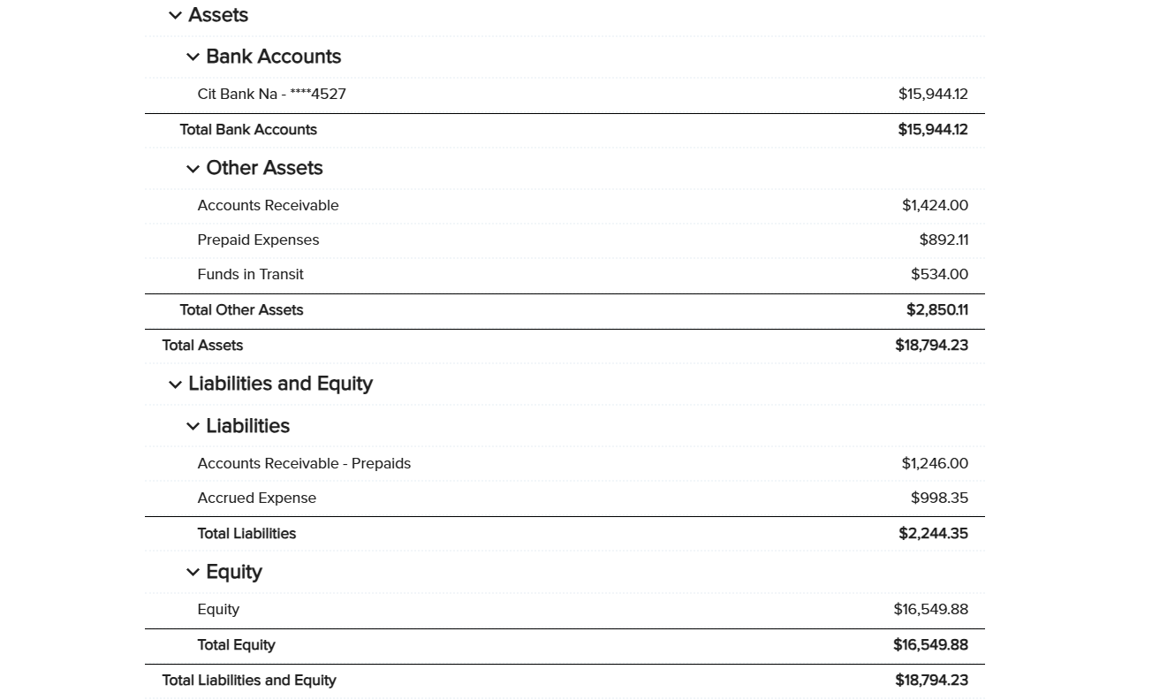
Financial Report: Balance Sheet 12/31/2024
2025 ANNUAL MEMBERS MEETING

Slide 4
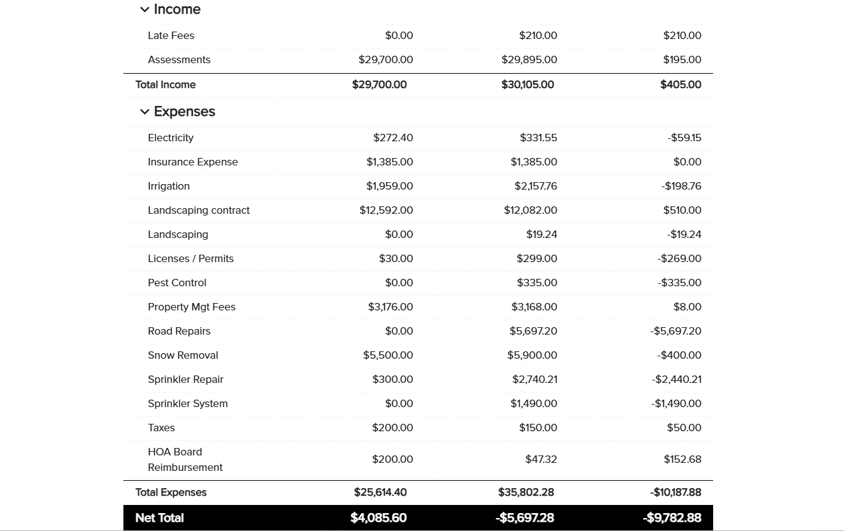
Financial Report: Budget vs. Actual 2024
2025 ANNUAL MEMBERS MEETING

Slide 5
Financial Report: Reserve Snapshot
2025 ANNUAL MEMBERS MEETING
YTD: $17,125.03

Slide 6
2025 Budget Review
2025 ANNUAL MEMBERS MEETING
Total Spend
$29.3k

Slide 7
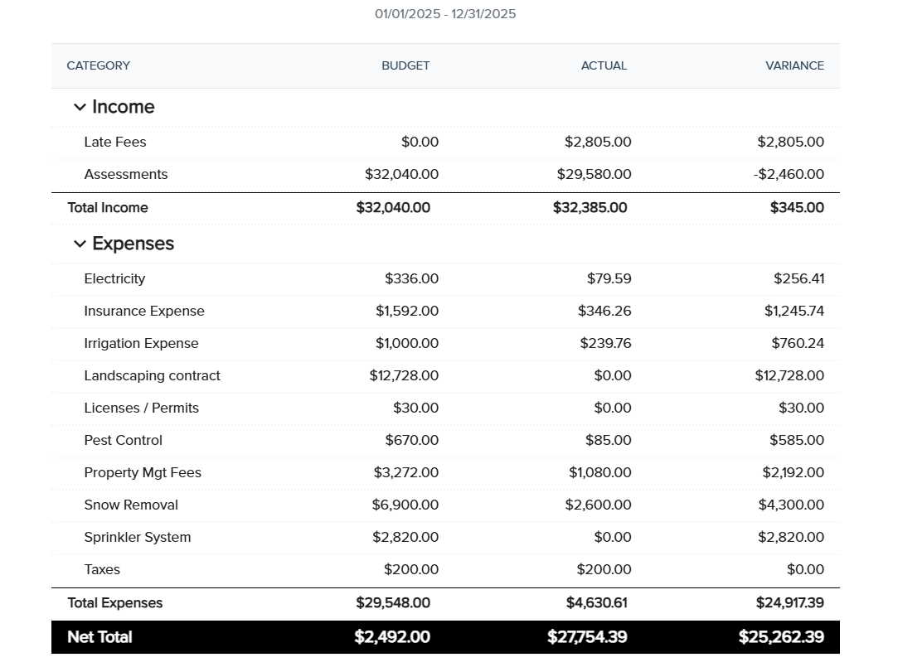
Budget Review: YTD Performance
2025 ANNUAL MEMBERS MEETING

Slide 8
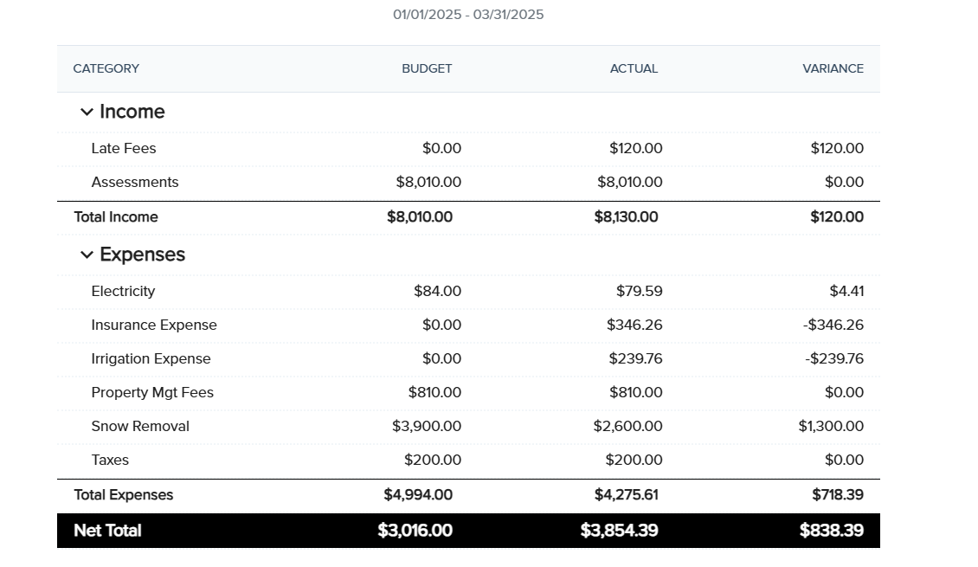
Budget Review: YTD Performance
2025 ANNUAL MEMBERS MEETING

Slide 9
Contract Review
2025 ANNUAL MEMBERS MEETING
Landscaping: Curtis Lawn Service – Monthly lawn service – mowing & edging, post emergent, wild grass trimming, fertilization, bush & tree trimming.
Sprinkler Repair: Frog Bottom Irrigation – Start up, monthly sprinkler maintenance & repair, blowout
Pest Control: Natures Balance – Semi Annual Service

Slide 10
Nomination & Election
2025 ANNUAL MEMBERS MEETING
Now accepting nominations from the floor!
If you would like to nominate yourself or another member for the board seat, please let us know
The board seat in question is a three-year term, and we encourage all interested members to consider participating in the governance of our community.
Your involvement in the nominations process is valued and appreciated!

Slide 11
Voting
2025 ANNUAL MEMBERS MEETING
Now is your time to vote!
The link to vote will be posted in the chat on zoom. We will also send It out via email.

Slide 12
Election Results
2025 ANNUAL MEMBERS MEETING
Voting will be closed on 4/24/25

Slide 13
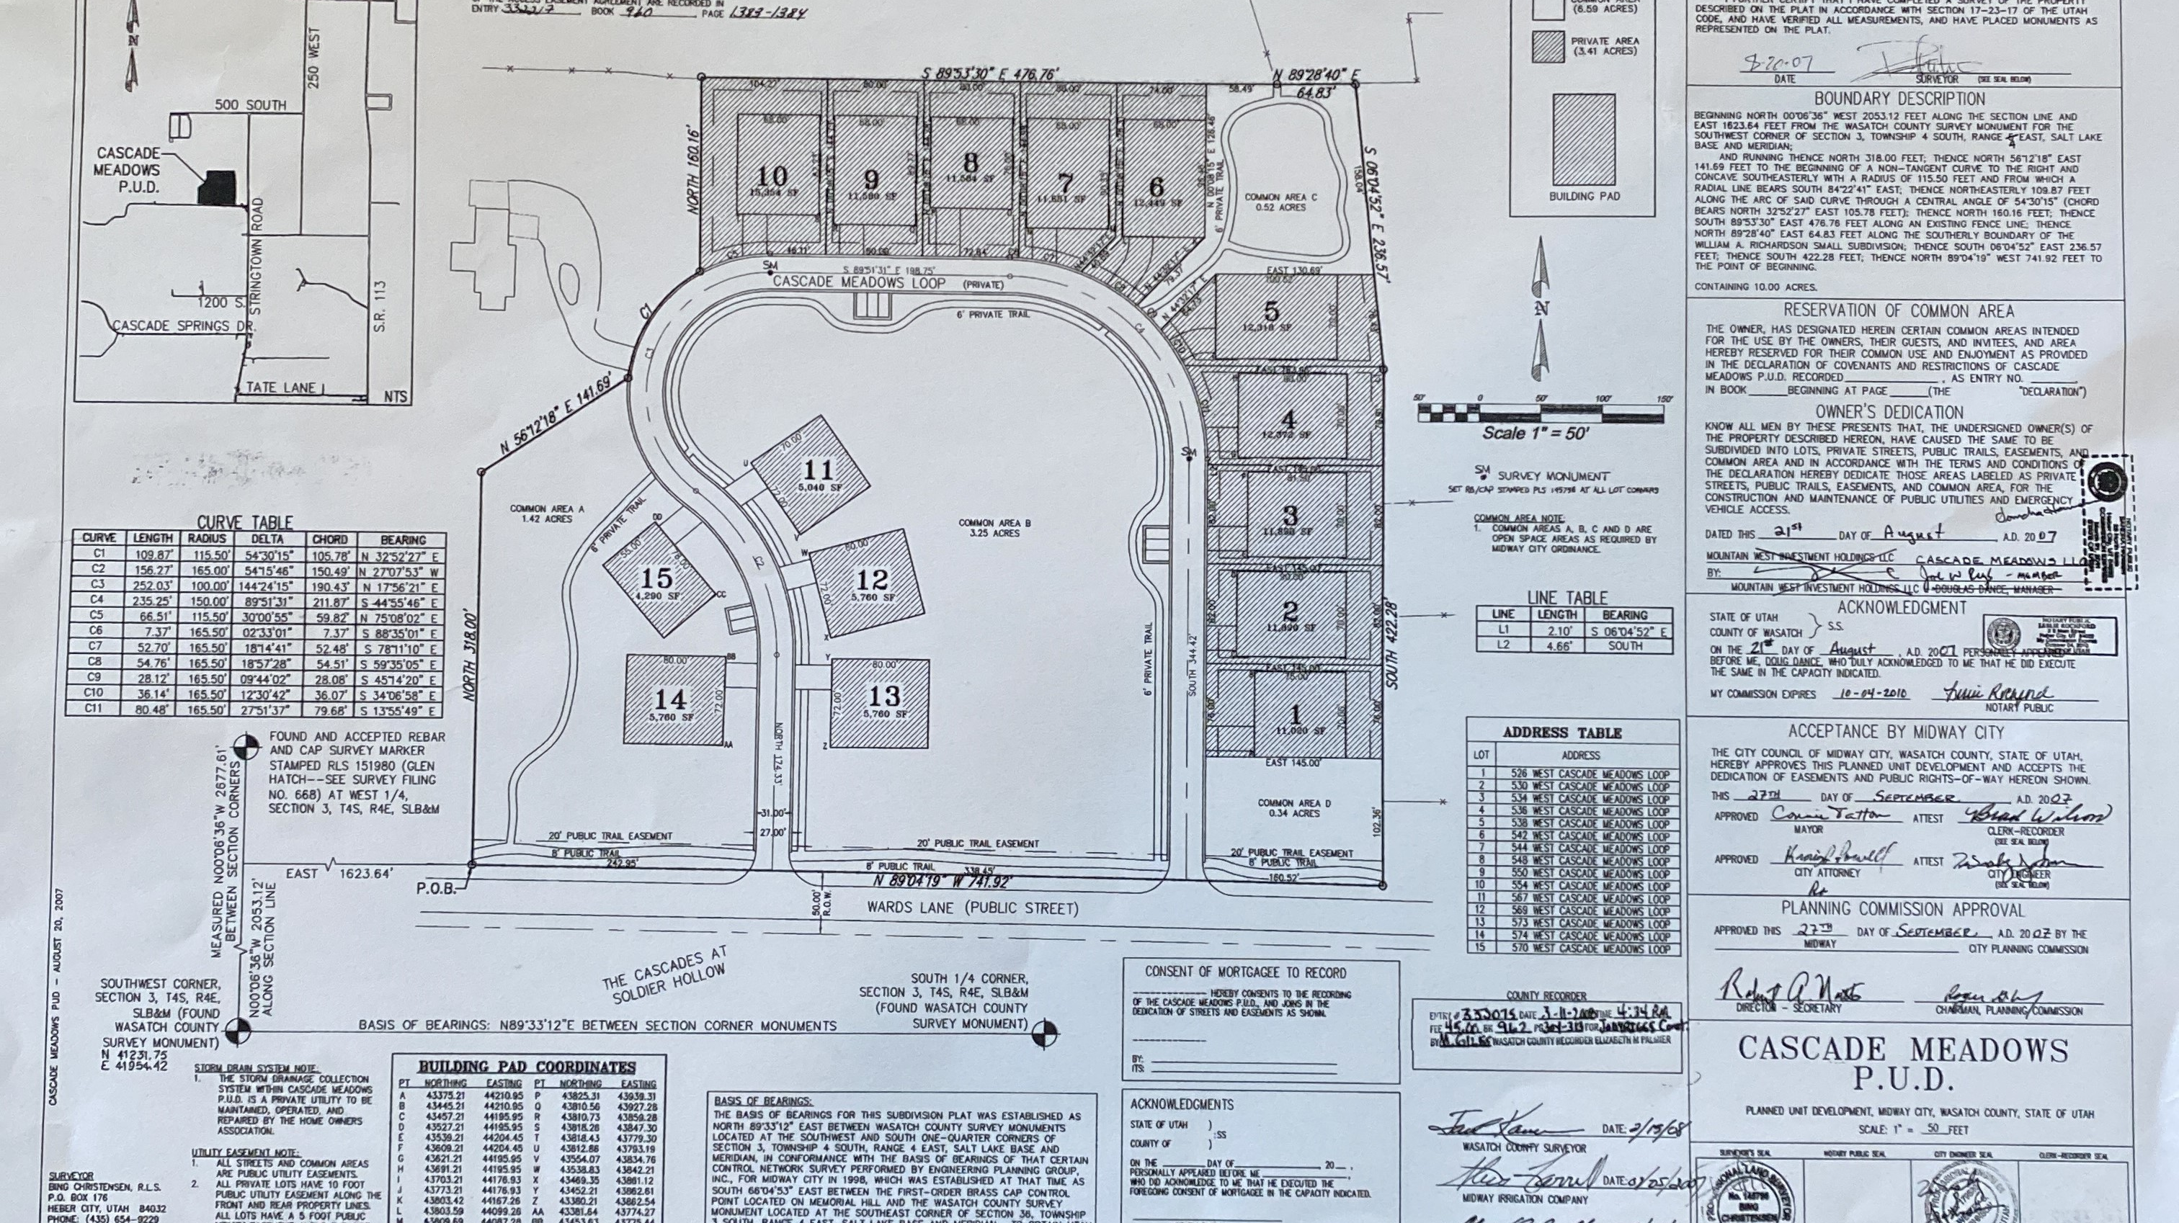
City & Plat Map Updates
2025 ANNUAL MEMBERS MEETING

Slide 14
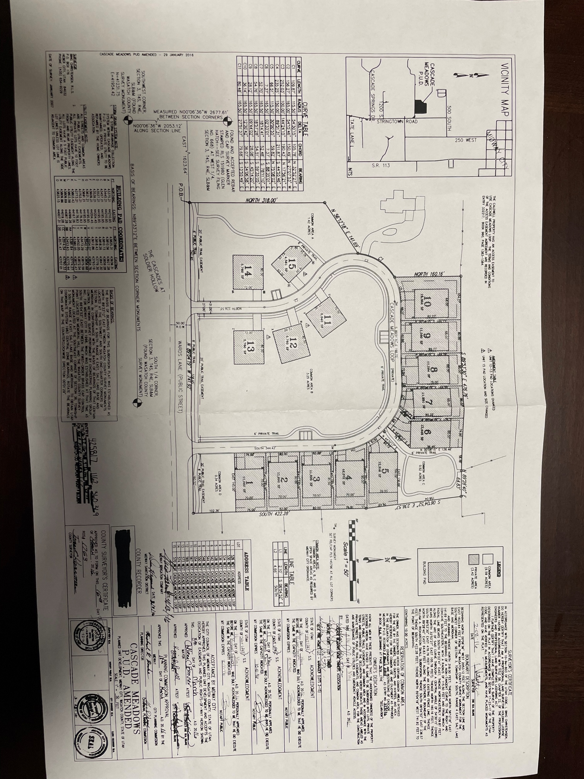

Slide 15
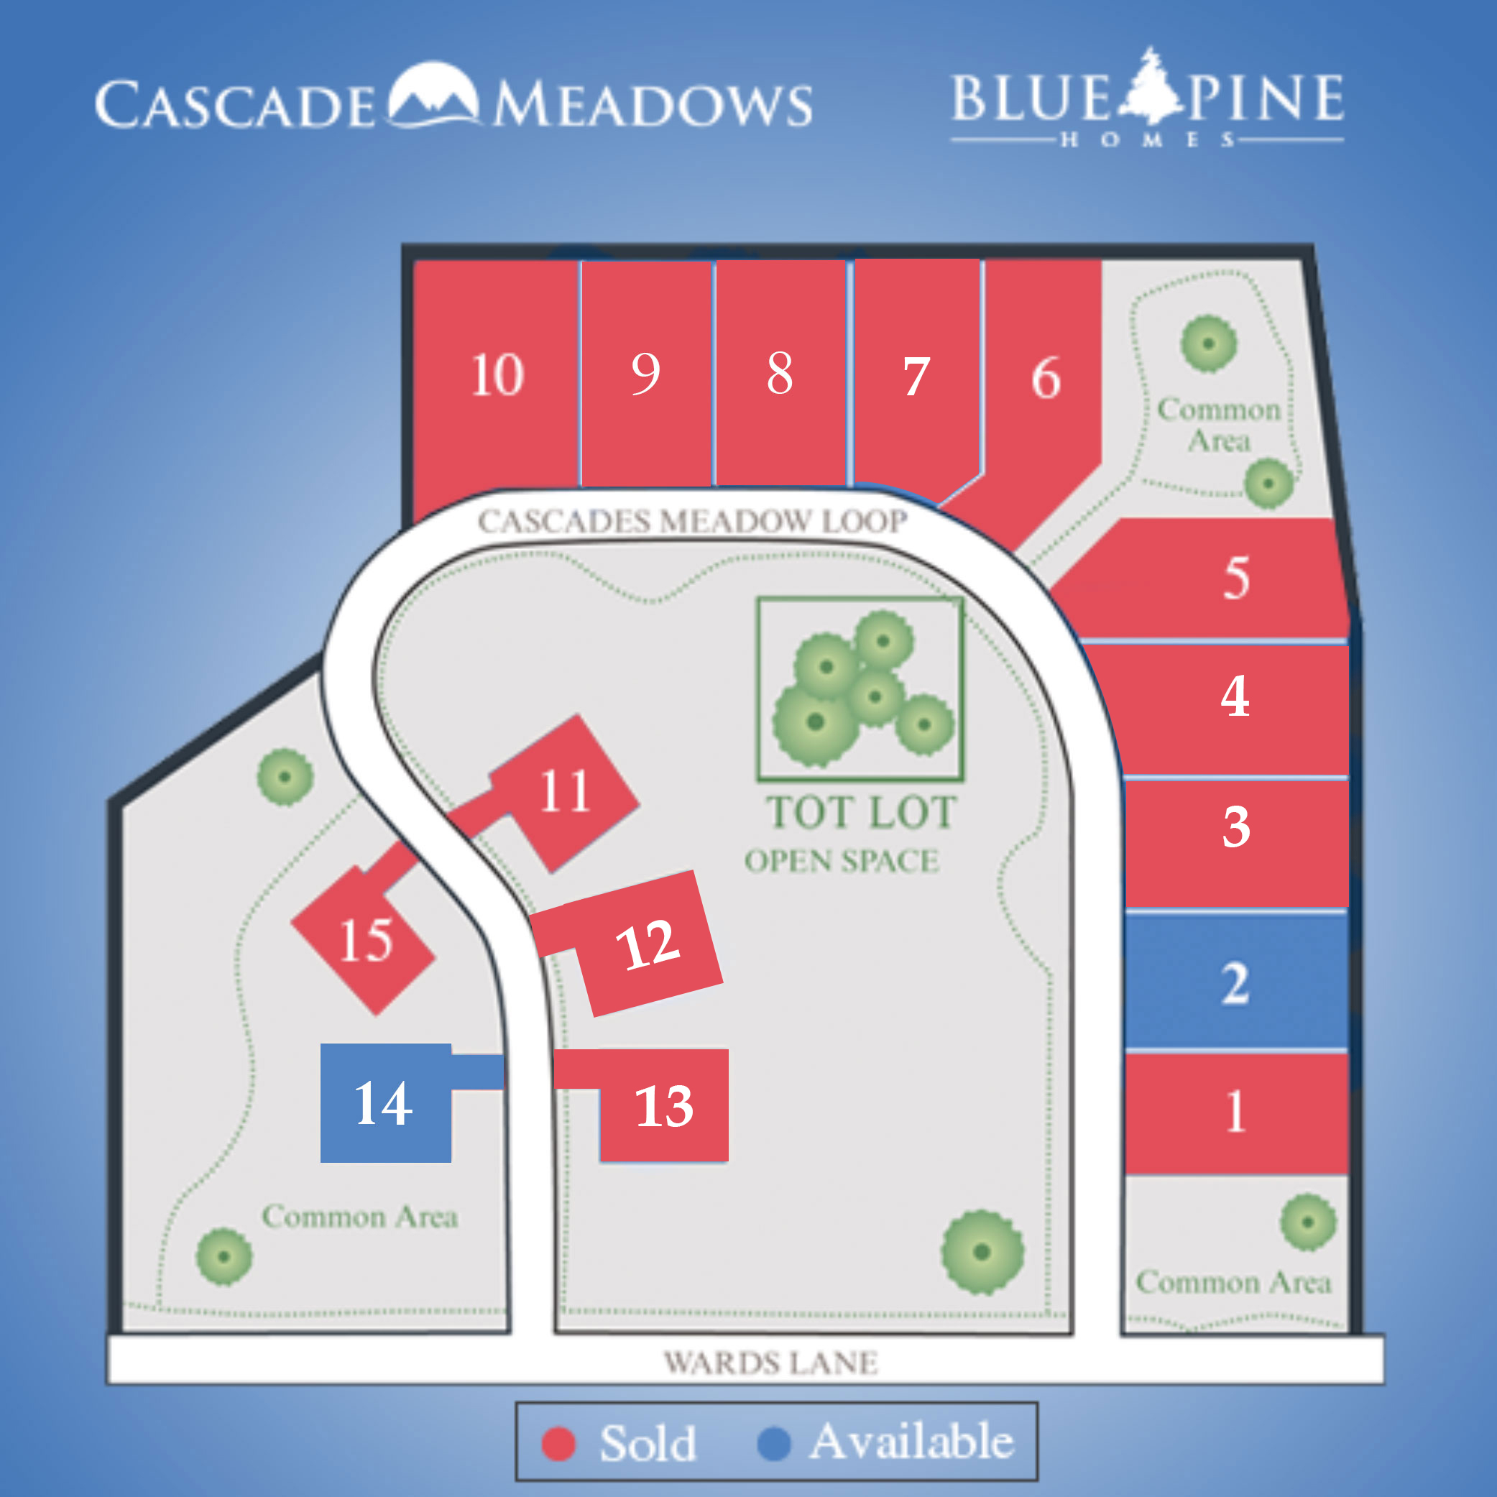

Slide 16

Irrigation Updates
2025 ANNUAL MEMBERS MEETING

Slide 17
Open Forum
2025 ANNUAL MEMBERS MEETING
We want to hear from YOU!

